Slide 1


大模型系列 – 大模型算法
S4 结构化状态空间
ZOMI

Slide 2
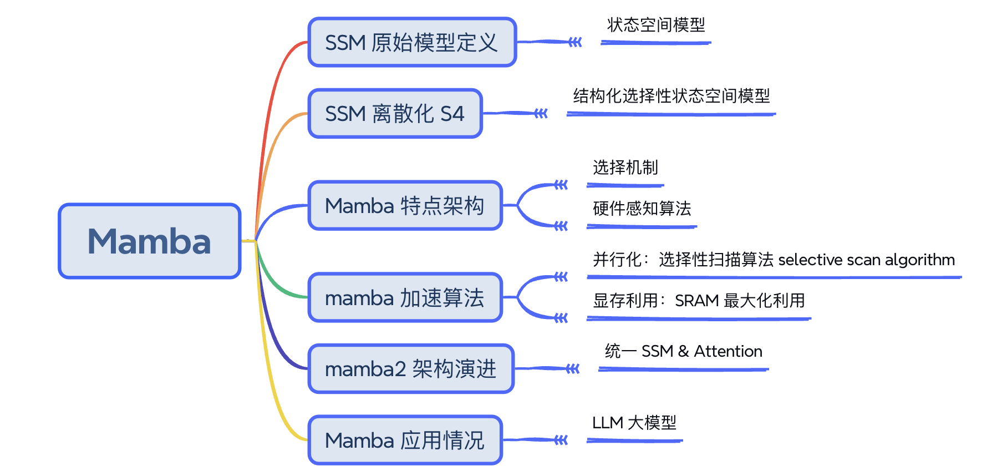
Mamba

Slide 3
本节内容
XXX

Slide 4
01
连续 to 离散

Slide 5
Structured State Space for Sequences (S4) 组成
State Space Models 状态空间模型
HiPPO for handling long-range dependencies，处理长距离依赖关系
Discretization for creating recurrent and convolution representations，离散化创建 RNN 表示

Slide 6
05
小结与思考

Slide 7
Mamba

Slide 9
Reference 参考&引用
https://srush.github.io/annotated-s4/
https://huggingface.co/blog/lbourdois/get-on-the-ssm-train
https://en.wikipedia.org/wiki/State-space_representation
https://arxiv.org/abs/2405.21060
https://github.com/state-spaces/mamba?tab=readme-ov-file
https://readit.plus/a/mo3u2/a-visual-guide-to-mamba-and-state

